Slide 1
AdaParse
Carlo Siebenschuh, Kyle Hippe, … Robert Underwood, Ian Foster
TPC Hackathon

Slide 2
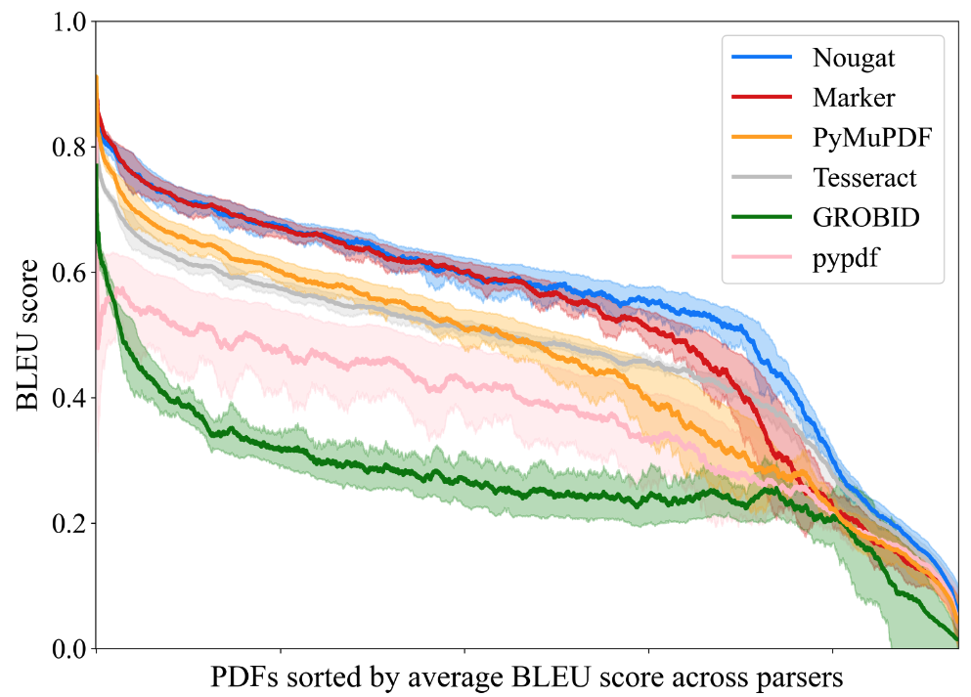
Accuracy across Parsers
setting 25k PDFs (ArXiv, MedRXiv, MDPI, BioRXiv, Nature, BMC); digital-born
parser performance varies but is correlated (for most PDFs)
performance comes at different cost:
Extraction = fast
OCR/ViTs = slow
PyMuPDF: 50x faster than Nougat

Slide 3
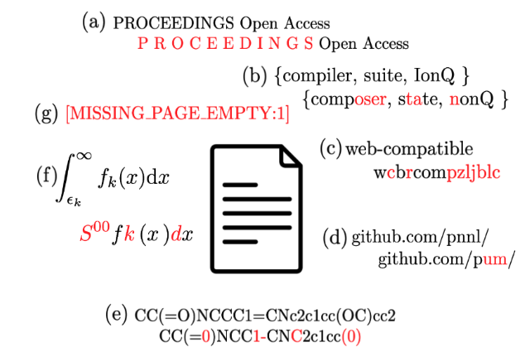
Accuracy across Parsers
Science communicates efficiently
acronyms/LaTeX
parsing mistakes are subtle but significant
`pH` vs. `Ph`
SMILES strings
All Parsers fail on some PDFs
efficient mix of parsers helps
Crucial for RAG/knowledge graphs:
names/institutions
references
Text quirks are informative
LaTeX → plain text
substrings separated by whitespaces

Slide 4
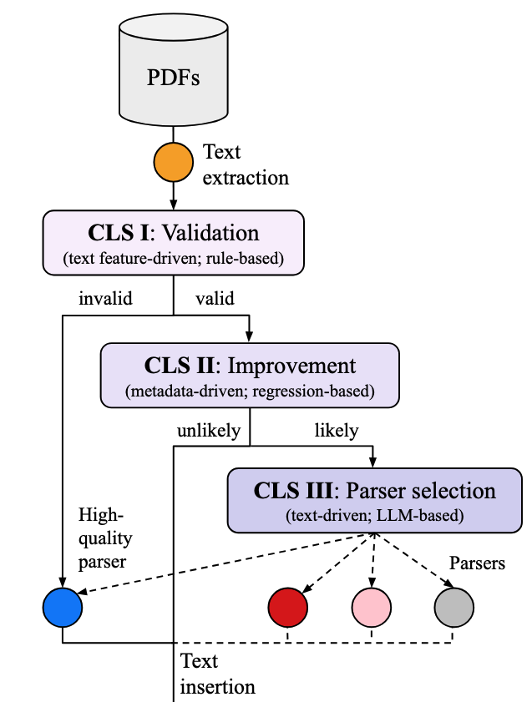
System Architecture
Hierarchical classification
ask good/slow models only if you have to
→ improved throughput
like any ensemble technique: combine moderately good parsers into a very-good parser strategy
Mostly: Fast parser (PyMuPDF) if possible, Nougat when needed
AdaParse ~ AdaBoost

